Slide 1
Online Exams Solution
Secure with Artificial Intelligence (AI) Proctoring

Slide 2
Online Examination
STUDENT
ADMIN
PROCTORS
Self Registration
Leader Board, My Exams
My Result, Performance
Manage Exams, Student, Users, Packages, Subjects, Question Paper, Topic and Sub-Topic, Student Portal Content
Live Monitoring, Suspect videos, Multiple student live Monitoring, AI-Reports

Slide 3
BUSINESS BENEFITS
Online Examination
LOWER COSTS
SAVE TIME
WIDER REACH
MORE SECURE
Infrastructure
Manpower
Logistics
•Planning & Coordination
•Evaluation, Result Generation
•Award Certificates
•No Geographical Constraints
•Larger Candidate Pool
Prevent Content Leak
•Remove Impersonation
•Auto Invigilate Every Candidate

Slide 4
Simple Steps To Conduct Examination
SETUP EXAM
REAL-TIME RESUL TS
Bulk Upload questions
Multiple question types supported
Configure Result
01
Customize results
Real-time result generation
Share results in pdf, html formats
04
INVITE TEST-TAKERS
GROUP-LEVEL ANALYTICS
Bulk upload candidates
Select time-slots
Distribute customized invite /follow-up mails
02
Group-level reports
In-depth analytics
Customize as per
05
AUTHORIZE & PROCTOR TESTS
AI-REPORTS
ID-based Authentication
Record entire test
AI-based & Human proctors
03
Entire test reports
Suspects Reports
Suspected activity Reports
06

Slide 6
Secure Online Exams
AUTO PROCTORING
(AI flags)
RECORD & REVIEW PROCTORING
(AI flags)
SECURE BROWSER
LIVE PROCTORING
(AI flags + Human Proctors)
APPLICANT
AUTHENTICATION

Slide 7
Features
AI- Artificial Intelligence
Live Proctoring (AI flags + Human Proctors)
Record & Review Proctoring with AI flags
Face Recognition
Behavior Detection
Weed out any suspicious cases
Block change window during exam
No screen recording & Sharing
Suspects Detected
90%
Suspects Accuracy
85%

Slide 8
AI-BENEFITS
Artificial Intelligence
NAVIGATION CONTROL
CANDIDATE AUTHENTICATION
ONLINE PROCTORING
SUSPECT DETECTED

Slide 9
AI- Work flow
Students
Exam Supervisions
Auto Verify Student by
face detection
Auto Marked student
Suspect Flag
Play the recorded
video
Suspected Students
Normal Students

Slide 10
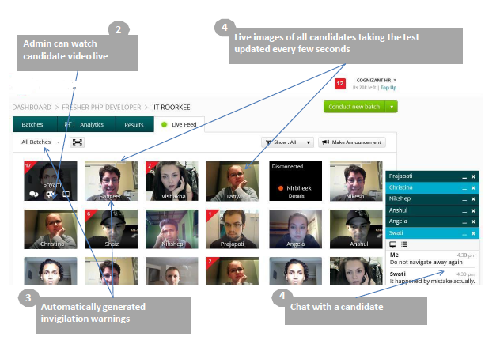
PROCTORING
Multiple Candidate

Slide 11
OUR SERVICES
Custom Software Development
Cloud Hosting – AWS, Hybrid Cloud
01
04
Mobile / Apps Development
Digital Marketing - SEO / SMO / Google Paid Ad words
02
05
Web Application Development
G suite Emails / Bulk SMS / Domains / Payment Gateway
03
06

Slide 12
Technology Expertise
Latest Technologies
Mobile
dot Net
Sharepoint
Xamarin
iPhone
Android
Flutter
Ionic
React Native
Open Source
Web
Node JS
PHP
ROR
Perl
Python
Shopify
Magento
Drupal
Joomla
Wordpress

Slide 13
ENGAGEMENT MODEL
01
02
Maintenance Contract
Resource leasing – Onsite
Resource leasing – Offsite
03
04
Portal Development Model
05
06
Hourly Model
Digital Marketing

Slide 14
OUR CLIENTS
GCX RELIANCE
HSBC BANK
HTC MOBILE
ENFAMIL
MASTEK
COUPLES ON CAKES

Slide 15
OUR CLIENTS
Business
Networking
HERBAL HILLS
LODHA BULDING
GBS BUSINESS NETWORKING
CHMISTDIRECT
TAPPED
VISION PROJECT

Slide 16
OUR PRODUCTS
APNI AMC
ME
Muke--Exam
MukeCRM
HERBAL HILLS
LODHA BULDING
GBS BUSINESS NETWORKING
EST
BN
Business
Networking
EasySalesTools
Community App
CHMISTDIRECT
TAPPED
VISION PROJECT

Slide 17
Thank-You
Mukesoft IT Consultants
Vishal Mehta (Director) Asha Parmar (BDM)
Email : : vishal@mukesoft.com Email : :asha@mukesoft.in
Mobile : : 9833079615 Mobile : : 9137858153
For More Details Visit www.mukesoft.com

